Slide 1
A Programmer: hates spagetti
Python Programming

Slide 2
Independent components
Only coffee_machine imports other component files (i.e. from other folders)
Components don't talk to each other

Slide 3
Passing Messages
State_machine
Passes arguments to components
Receives values back from components
Changes state when necessary

Slide 4
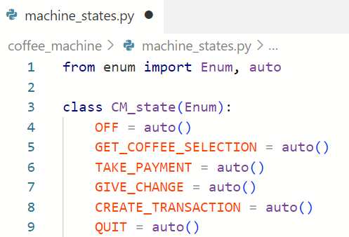
Define States

Slide 5
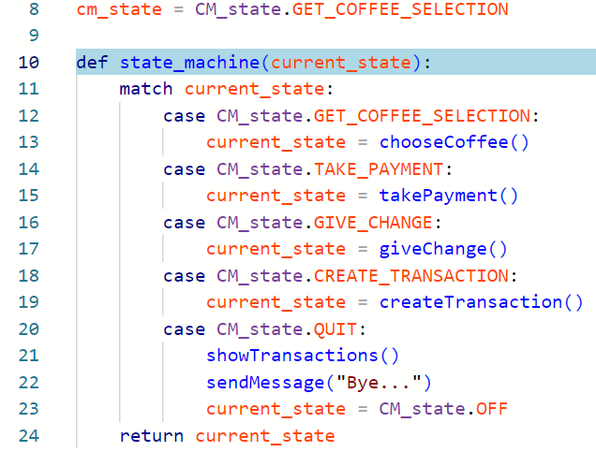
State Machine

Slide 6
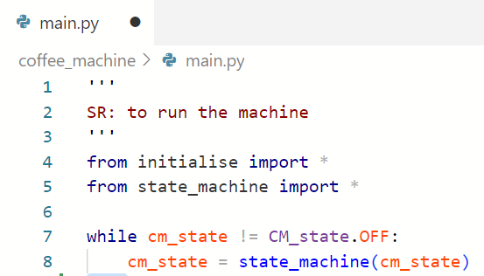
main()

Slide 7
Who Is Responsible?
What responsibilities does each component have?
Who is responsible for
Deciding the recipe for each coffee-type?
Deciding which types the machine can offer?
Processing Payments?
...

Slide 8
What is the UI responsible for?
Asking for input
Giving helpful prompts
Checking for valid input
Checking for in-range input
Returning the answer
Reporting problems
Knowing what coffee-types are called?
Knowing what coffee-types are available?

